Slide 1
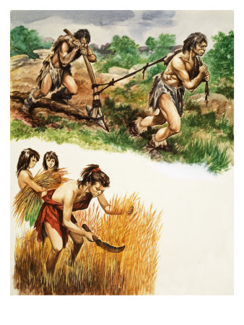
The first form of roads can be traced back to transporting goods in the Stone Age

Slide 2
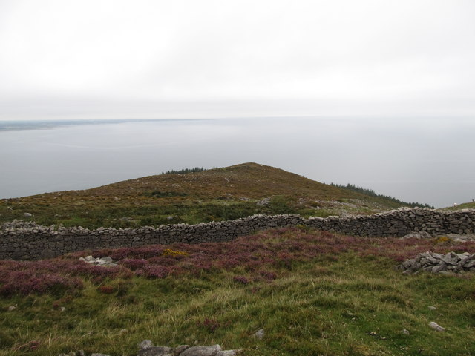
5000BC
Routes developed along ridges in England to avoid crossing rivers & bogs

Slide 3
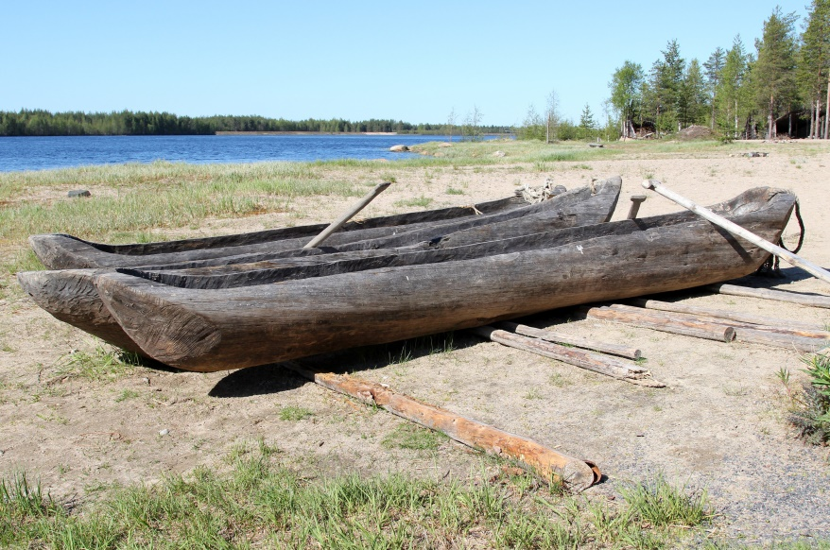
Bronze & Iron Age transport often took place by water

Slide 4
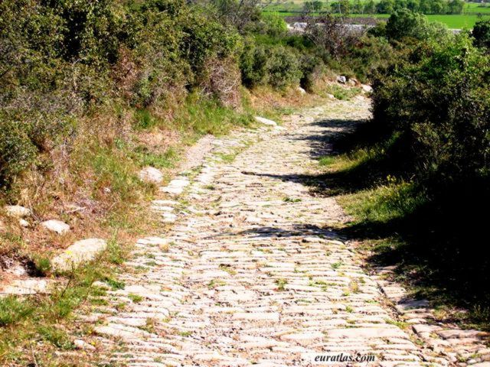
1st Century AD
Roman roads were constructed
..

Slide 5
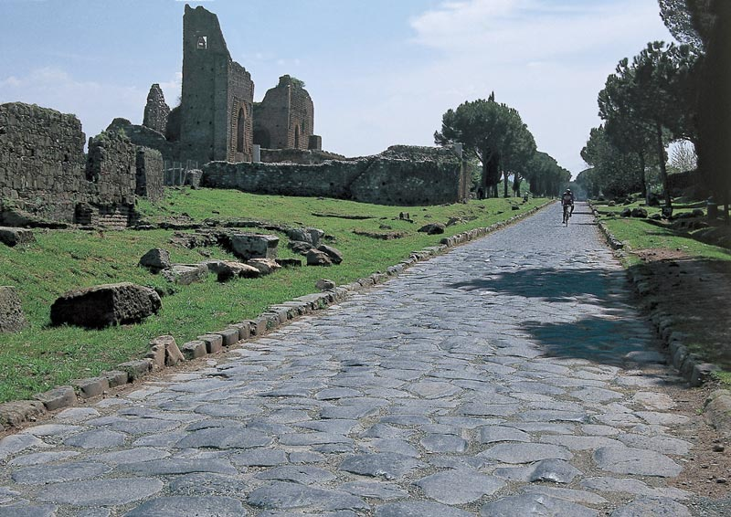
The Roman roads were well constructed to enable the army to travel quickly

Slide 6
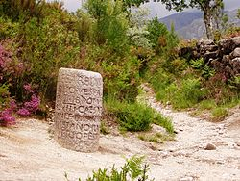
Milestones were set up at 1000 double-step intervals
Mille is Latin for 1000 – hence the word mile

Slide 7
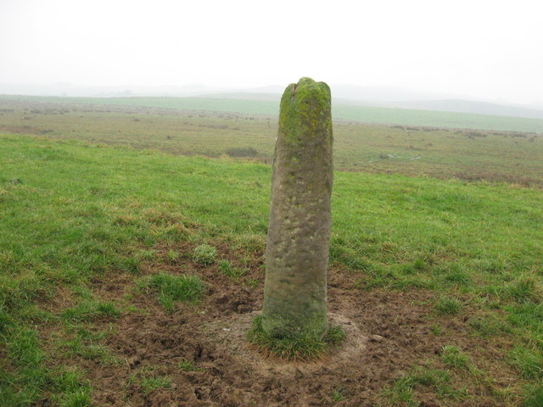
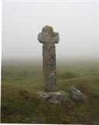
& other Waymarkers were used:
These helped people find the way to monasteries, along packhorse tracks, pilgrim routes and much more

Slide 8

1675 The first English Road Atlas was published

Slide 9
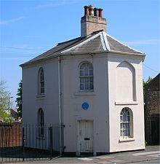
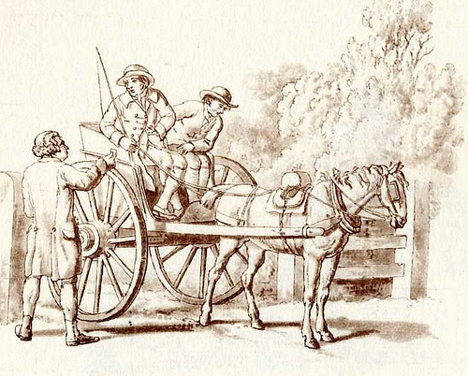
1704 The first Turnpike Trust Act was introduced
Trustees repaired roads and built new ones They charged tolls to pay for the roads
The toll or fee was paid at a Toll Gate before you could pass

Slide 10
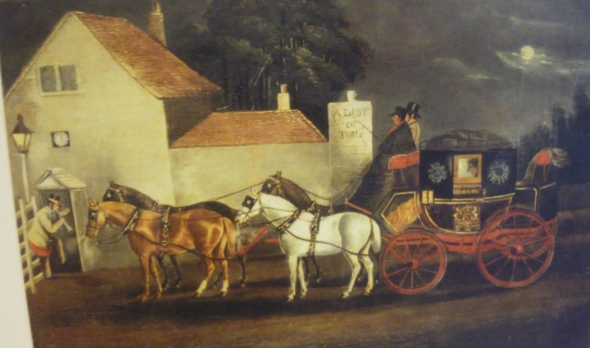
1767 Milestones became compulsory on turnpike roads
What were they used for?
Giving directions and distances
Charging for horse hire at coaching inns
Paying for mail before the introduction of the Penny Post in 1840

Slide 11
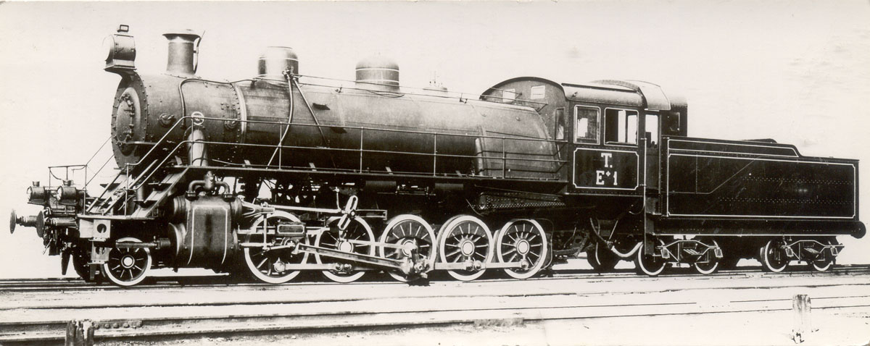
Then along came steam engines
And transport began to change…

Slide 12
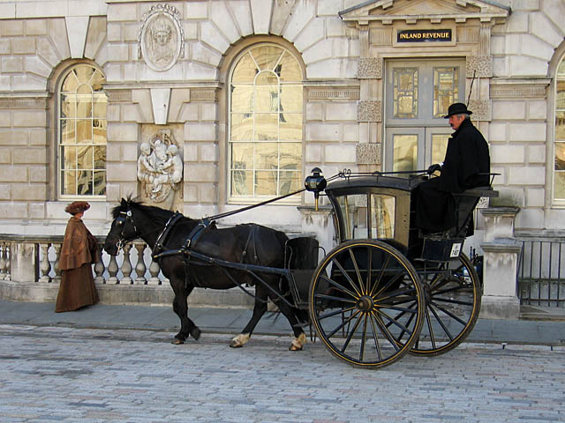
Rail replaced long distance road journeys
The highway robber had less chance of making a living!
Turnpike trusts were closed down and local councils took care of the roads
There was much congestion on the roads around the main town stations – the horse drawn cabs had to queue

Slide 13
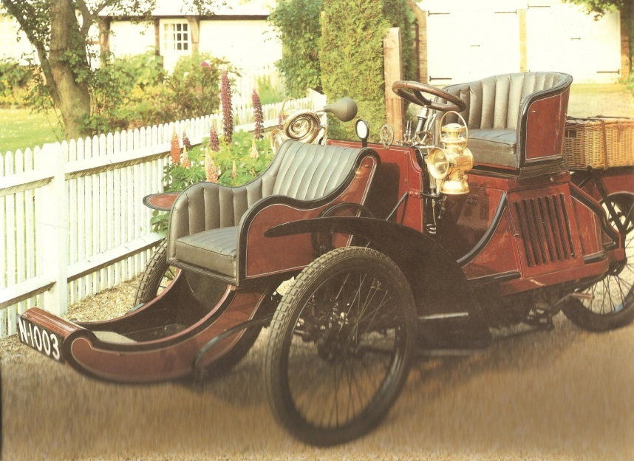
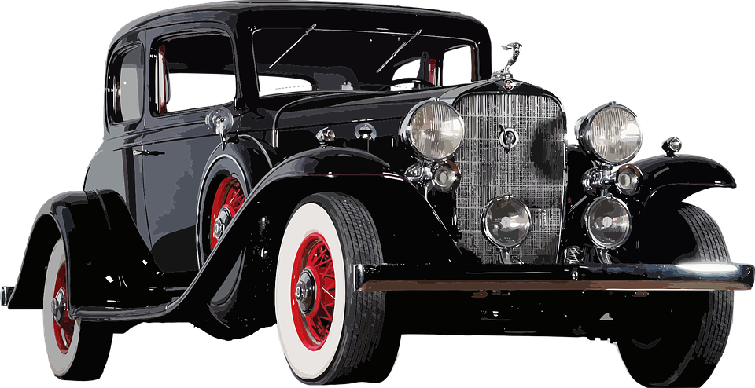
By 1896 there was a new form of transport
.

Slide 14
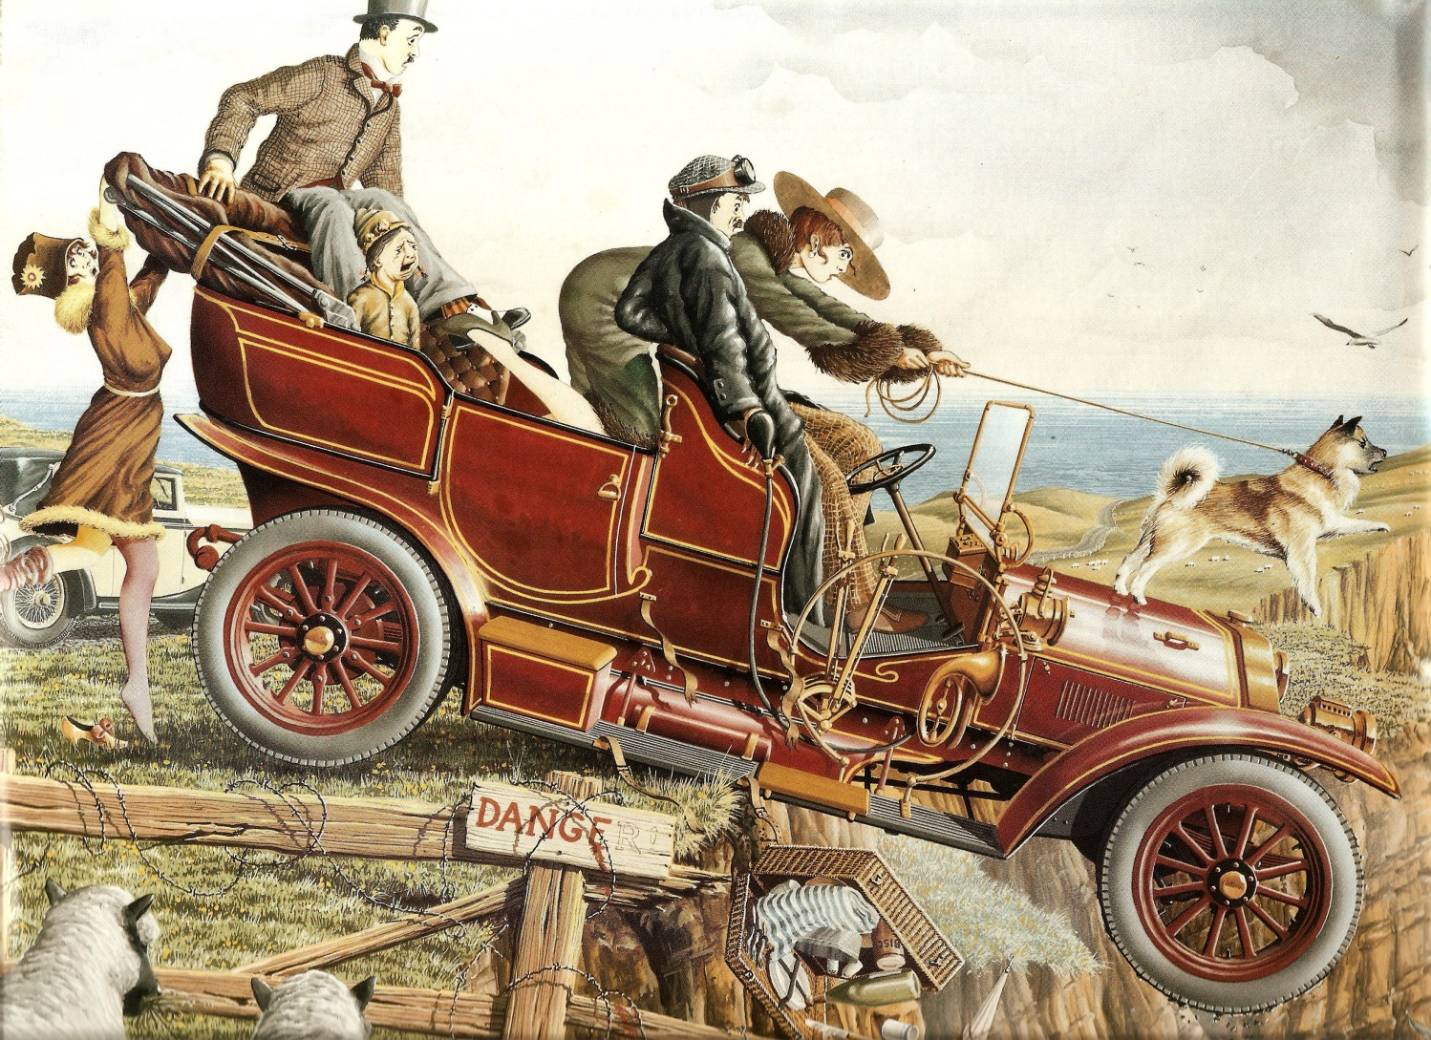
By 1910 there were quite a lot of cars
.

Slide 15
Things have changed over the centuries!
Can you think of any modern transport that we haven’t mentioned?
Make a list and discuss what transport might be like in the future too!

Slide 16
Turnpike Road
Activity A
Gallows Gate, Gibbet Hill
Bakers Lane
Thread Needle Street
Market Place
What do you think used to take place in those streets?
Many of the street names are still used today
Use Google Maps to find some other names that describe what happened there

Slide 17
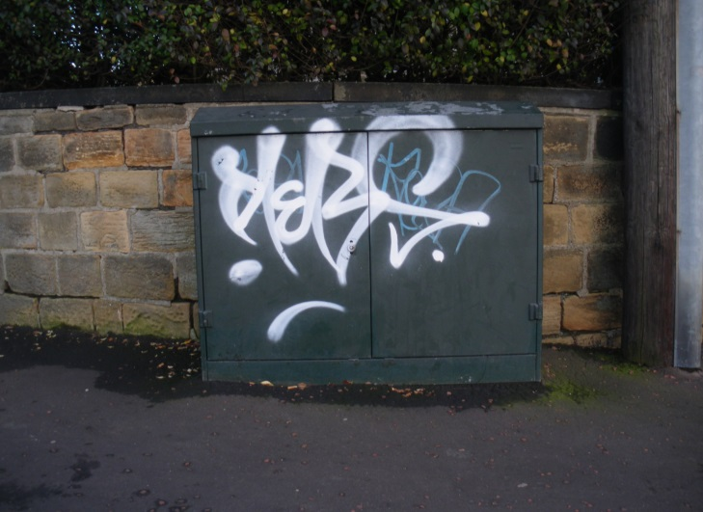
Draw Your Own Map
Make your own map and see what names you can come up with that describe a modern day activity, e.g :
Skateboard Alley
Graffiti Way
Dog Walk Green

Slide 18
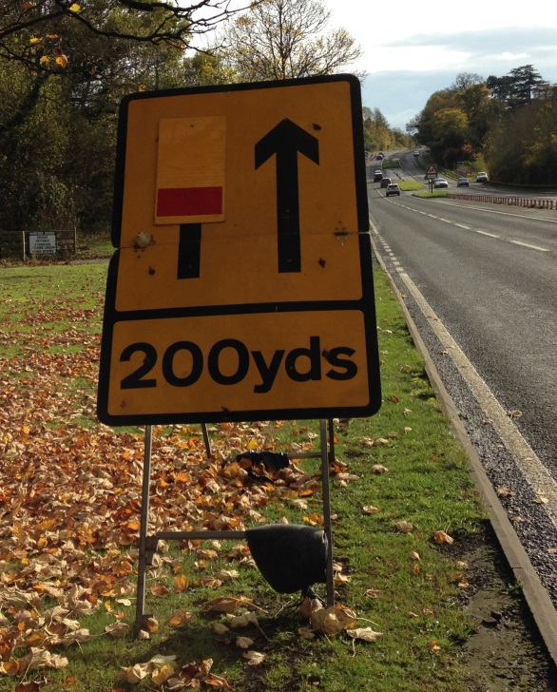
1600 statute miles were introduced
Additional Activity
This was 1760 yards
Can you measure this out in your playground:
1 yard = 91.44 centimetres
1 yard = 3 feet or 36 inches

